Slide 1
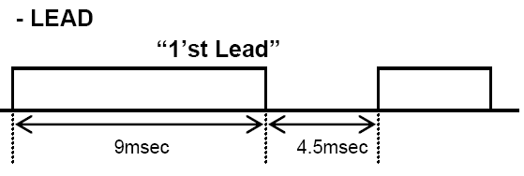
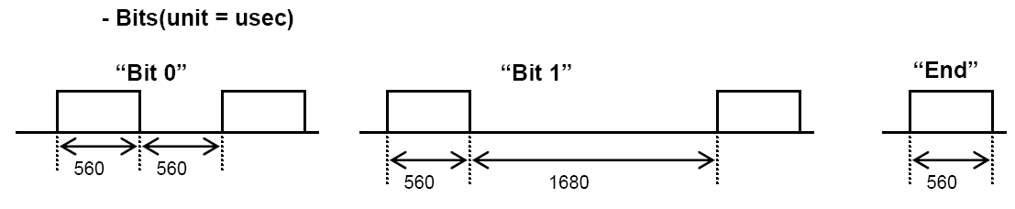
External Interrupt_Init()
- Set falling edge
Timer_CaptureMode_Init()
- Capture Mode Enable
- Set Timer Clock Source (Configure timer 1 clock period)
- Real Period = 1 clock period * capture data
IR_Rec_Init()
- IR_Data = 0;
- IR_DataCnt = 0; // Total 32bit = Custom(8bit)+bCustom(8bit)+Data(8bit)+bData(8bit)
- IR_LeadOn = 0; // When detect lead signal, it is changed ‘1’
# Sequence
- IR signal is received at external interrupt pin.
- When External Interrupt Flag is set, Capture data is loaded at register.
- IR received signal is reverse of the IR transmitted signal.
(Low output when there is a carrier and high output when there is no carrier )
# NEC Format (Transmit side)

Slide 2
# External Interrupt Service Routine
IR_Rec_Handler( )
Load timer capture data at timer buffer
// Timer_Buffer = TxCDR;
IR_Rec_Init()
No
fLeadOn?
No
LeadMin<
Timer_Buffer
<LeadMax
Yes
Yes
Shift IR_Data_bit << 1
fLeadOn = 1
fDataCnt = 0
Bit1Min<
Timer_Buffer
<Bit1Max
Yes
IR_Data_bit |= 1
fDataCnt ++
No
fDataCnt ++
Bit0Min<
Timer_Buffer
<Bit0Max
Yes
fDataCnt==32
No
No
IR_Rec_Init()
Yes
IR_API_Run()
IR_Rec_Init()
IR_API_Run( )
Convert IR_Data to UserData
// gu8CustomData = (unsigned char)((gu32IR_Data >> 24) & (0xFF));
// gu8UserData = (unsigned char)((gu32IR_Data >> 8) & (0xFF));
To use gu8CustomData and gu8UserData @ User Application

